Slide 1
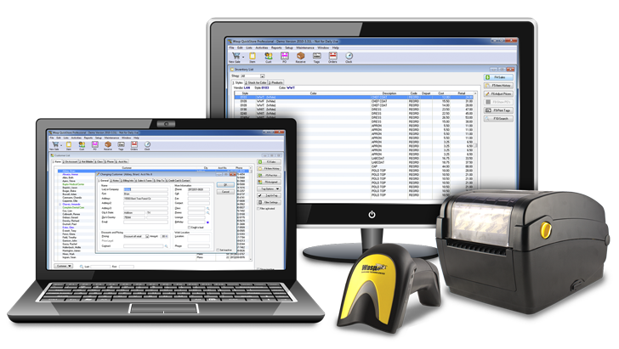
Point of Sale

Slide 2
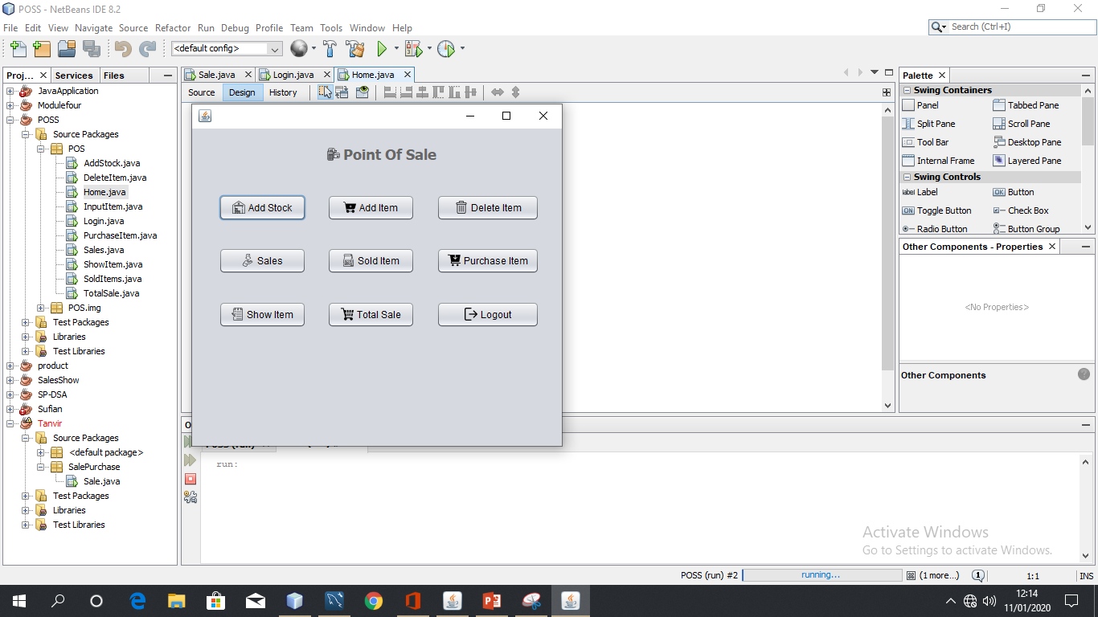
About Project
This Simple Point of Sale is a very basic application using graphical components in the Swing toolkit in Java. The feature of this simple application includes adding, updating, deleting and viewing stock items. Here you can perform the CRUD operations easily. This whole system is built using Java programming language with the help of Netbeans IDE. In order to add items, the user has to enter the item name, number, quantity, and price. The user can also add stocks of the available items by providing item number and quantity. In order to purchase an item, he/she has to provide item number and quantity. After this, the system will display a total bill of the customer.

Slide 3
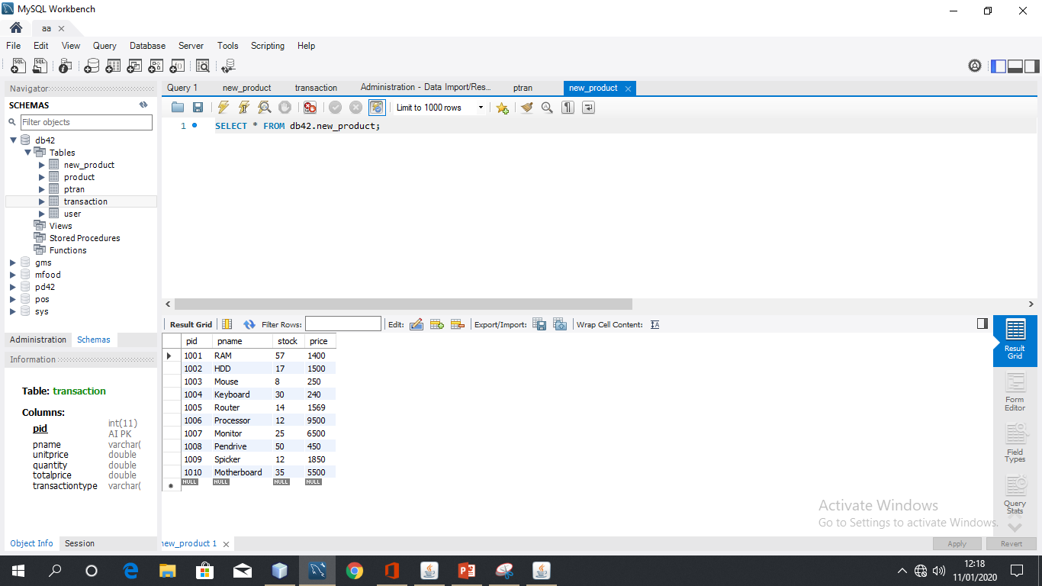
About Project
It also contains a feature that allows a user to view all the total sales of the day and the number of sold items in a list view. All the stock item records can also be deleted by the users according to their will. The application does not connect to any external database for holding users record permanently. This means all the records are stored temporarily. Design of this project is pretty simple so that the user won’t find any difficulties while working on it. To run this project you must have installed Netbeans IDE on your PC. Simple Point of Sale in Java with source code is free to download, Use for educational purposes only! For the project demo, have a look at the image below.

Slide 4
WHY USE POINT OF SALE ?
One of the focal points of any retail or hospitality business is the cash register. The ability to process transactions and tender cash are essential to the efficient operation of the enterprise. If you have a lot of cash transactions, replacing the cash registers with a Point-Of-Sale (POS) system save you money. A POS system is computer software and hardware networked together to track sales and inventory as they occur. POS systems will solve a multitude of problems in your business.

Slide 5
BENEFITS OF USING POINT OF SALE
Efficient transaction processing
Most POS systems are just very sophisticated cash registers. A good POS system will cut down on or even eliminate any “human errors” that occur in merchant processing of transactions. For example, most restaurants that do not use POS systems are susceptible to the risk of order errors due to poor communication between waiters and kitchen staff. Some retail stores have separate terminals for sales computation and credit card processing. A good POS system can fix these problems, cutting down on employee error and making communication between different parts of the business much easier.

Slide 6
BENEFITS OF USING POINT OF SALE
Better record keeping
POS systems standardize the format and recording of transactions, keeping a record of daily sales that is organized and easy to understand. This can be valuable to service businesses, like restaurants, which rely on precise records like calculating tips for employee tax information. A POS system records every relevant piece of information about a transaction: the employee who performed it, the amount, and the items or services purchased.

Slide 7
BENEFITS OF USING POINT OF SALE
Effective use of information
POS systems allow a business to use information more effectively. For example, most POS systems have reporting functions, where a business owner can generate a list of sales by category, by date, or by employee for any given time period. If your business is deciding whether or not to place an order for a certain product, you can obtain a detailed outline of all past sales information.

Slide 8
BENEFITS OF USING POINT OF SALE
Cost savings
The chief reason most businesses choose to purchase a POS system is cost savings. If you are keeping track of your inventory, saving time with computer generated reports and targeting those key customers that spend the most, you’ll increase your business’ profits. A good POS system makes it difficult for employees to give unwarranted discounts or free merchandise away because inventory is better controlled. Problems with security or inventory control can be addressed sooner and more specifically and you’ll also be able to make day-to-day business decisions based on real data.

Slide 9
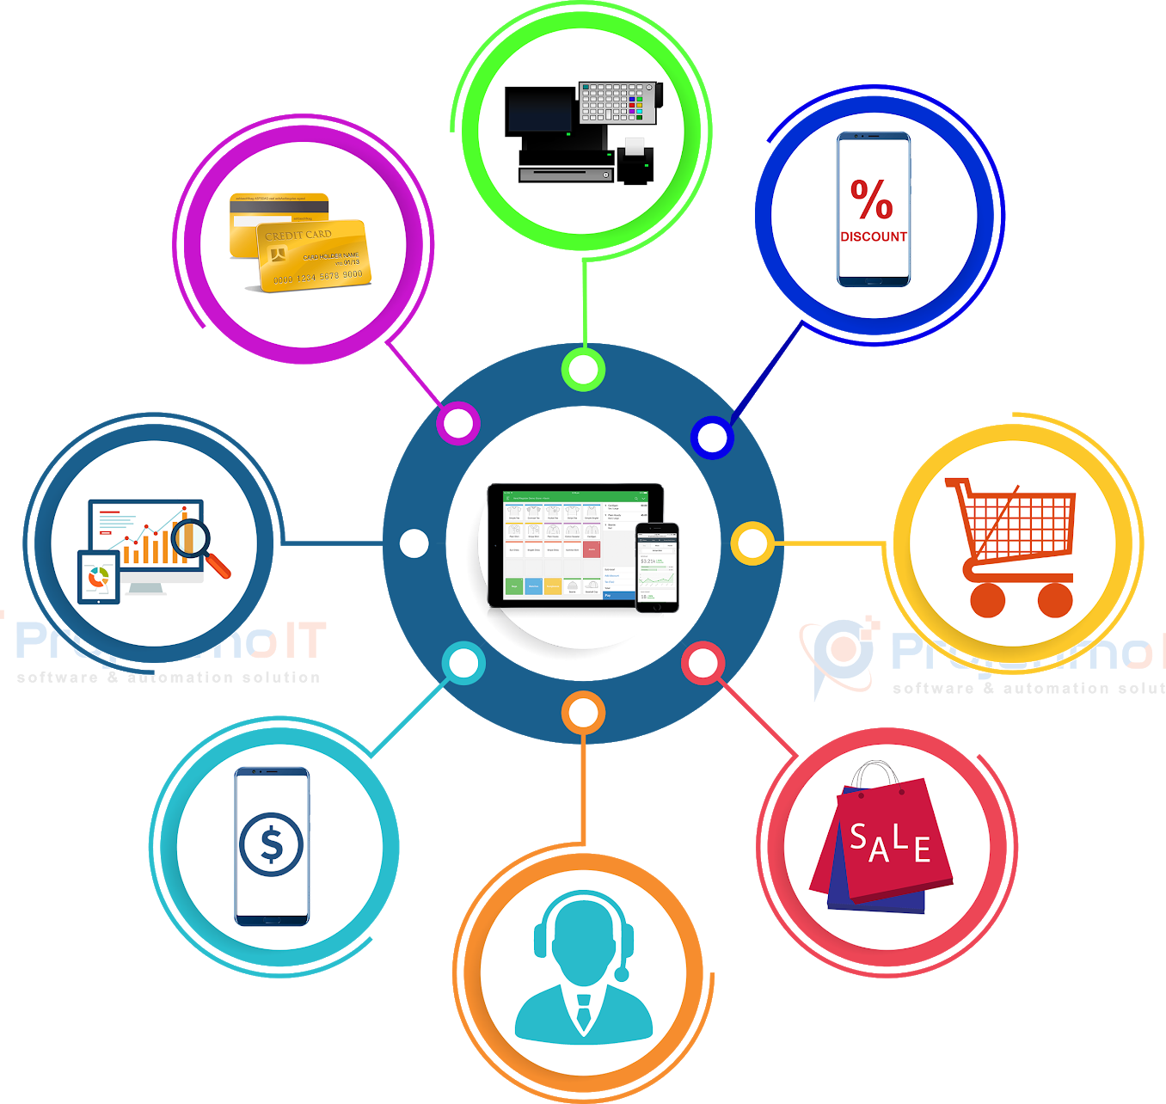
Features
Add stock
Add items
Sale
Purchase
View total sales
View sold items
View purchase items
Delete and list total items
Login and logout

Slide 10
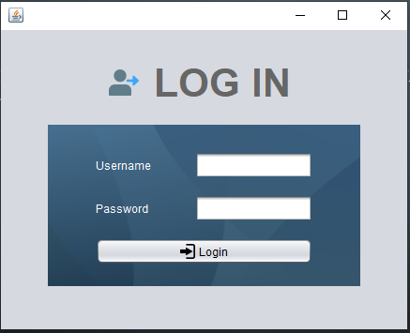
LOGIN PAGE
Insert User Name
Insert User Password
Now press Login button

Slide 11
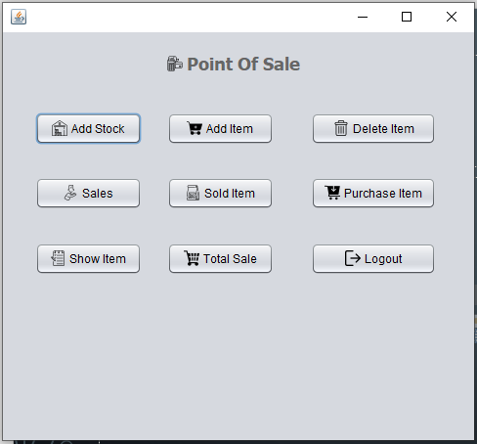
HOME PAGE
Select Choose Your Option

Slide 12
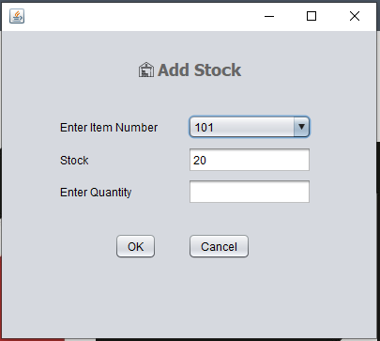
ADD STOCK
Select item number & Automatic show previous stock.
Choose the quantity of product.
Now press ok button

Slide 13
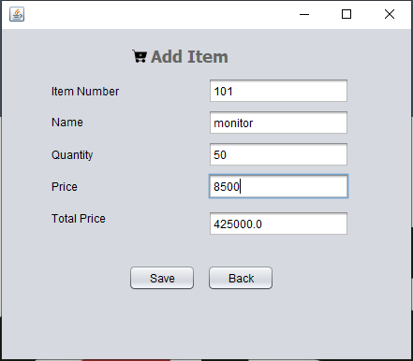
ADD ITEM
Enter Product Item Number
Enter Product Name
Enter Product Quantity
Enter Product Price
Now Press Save Button

Slide 14
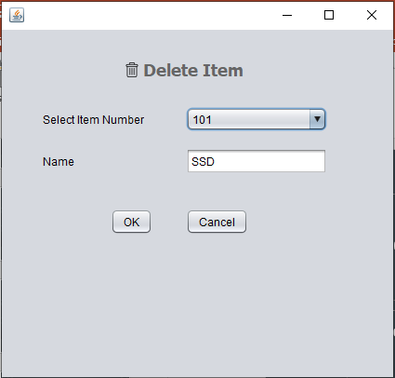
DELETE ITEM
Select item number
Now press ok button

Slide 15
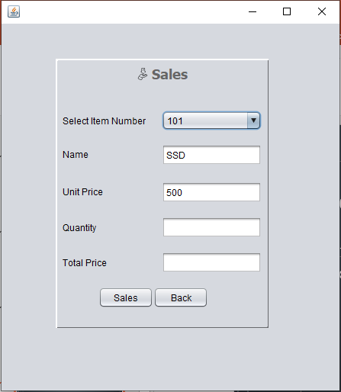
SALES
Select item number & Automatic show product name and unit price.
Choose the quantity of product.
Now press sales button

Slide 16
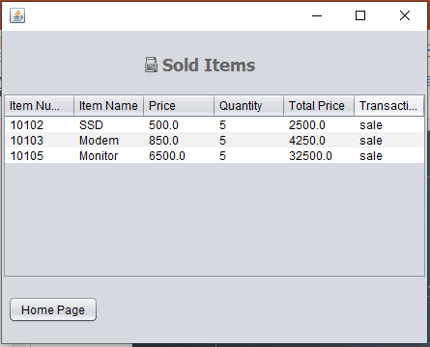
SOLD ITEMS
Show All Sold Item

Slide 17
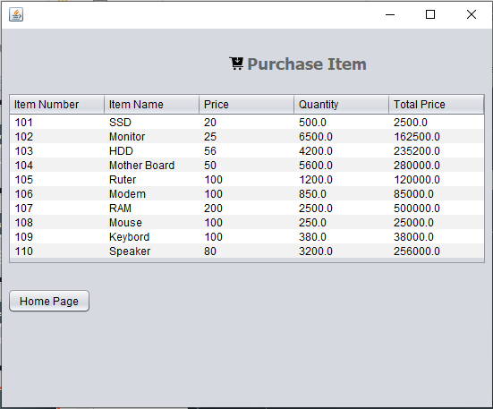
PURCHASE ITEMS
Show All Purchase Item

Slide 18
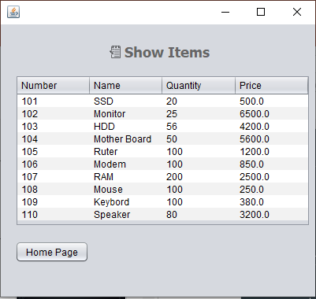
SHOW ITEMS
Show All Product Item

Slide 19
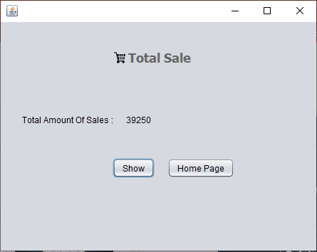
TOTAL SALE
Press Show button & Show Total Amount of Sale

Slide 20
THE END
THANK YOU!!!

